Slide 1
Insurance

Slide 2
Aim : Creating a model to predict whether a person will buy the insurance or not.
Logistic Regression - To solve classification problems.
Predicted Value (Y) is categorical / discrete.
Binary Classification - It has outcome as Yes/No or True/False.
Multiclass Classification - It has multiple categories for outcome.
In binary classification, the outcome is either 0 or 1 (Between 0-0.5 = 0 : Between 0.5-1 =1 ).
Sigmoid - It is a mathematical function having a characteristics S-shaped curve or Sigmoid curve. This curve exists between 0 and 1.
It is especially used for models where we have to predict the 'Probability' as an output, because the probability exists between 0 and 1. It converts the input into range 0 to 1.
Step 1 - Importing Necessary Libraries
Step 2 - Importing the data-set
Drawing a Scatter plot to see the distribution of data-points
Step 3 - Training the model
Step 4 - Start Making Predictions
Checking the score of the model

Slide 3
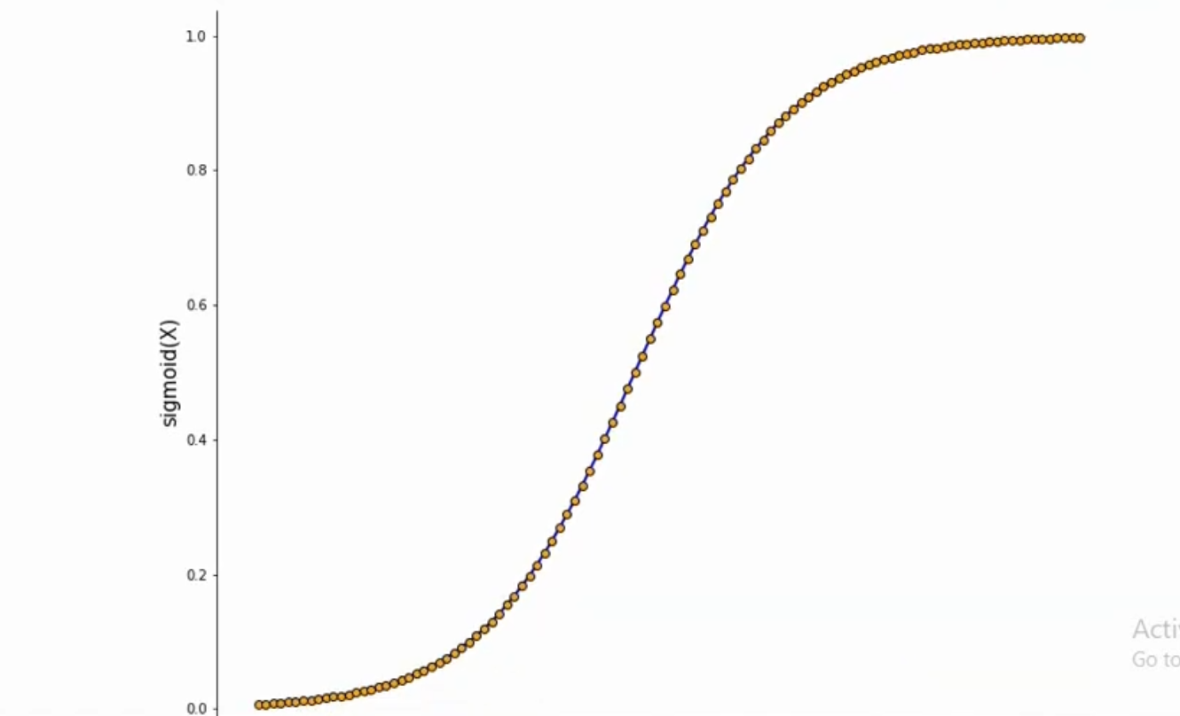
Sigmoid curve

